Slide 1
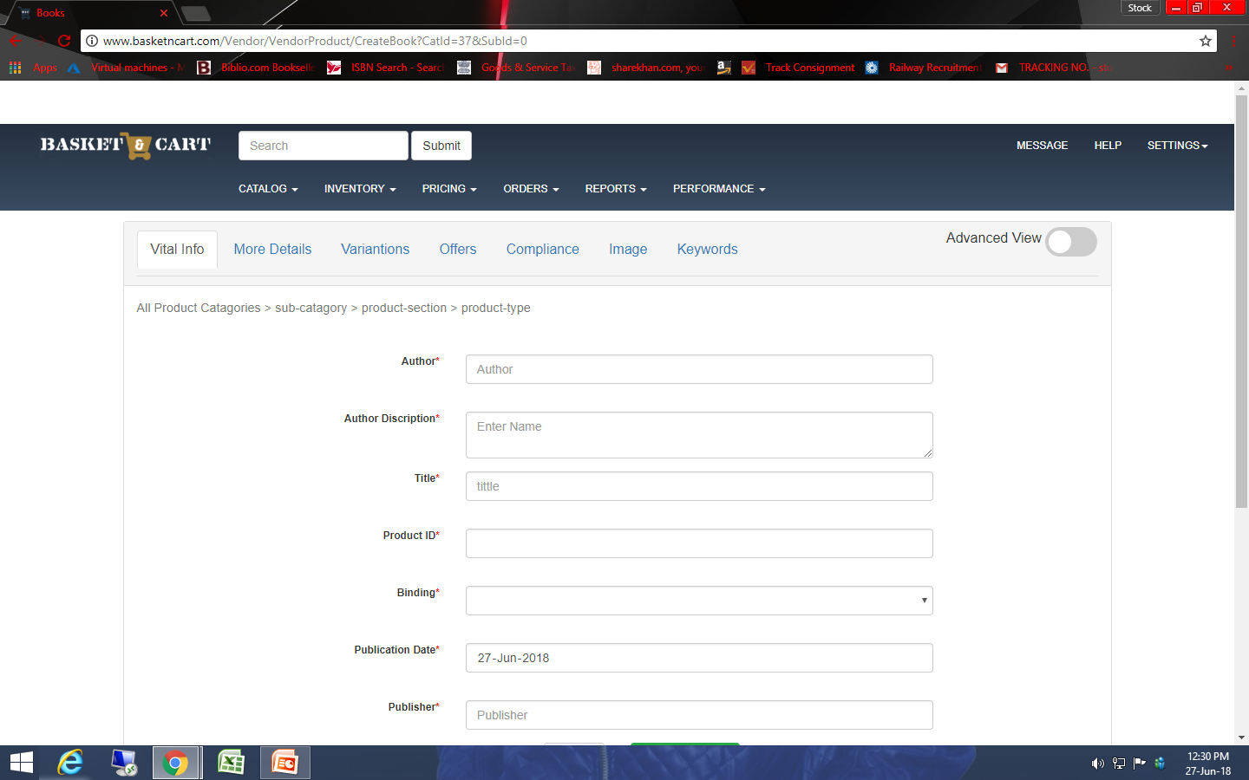
75. Coloum is auto blacked while changing page.

Slide 2
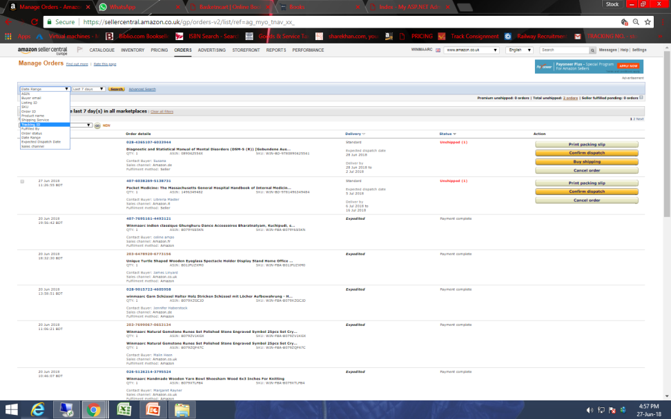
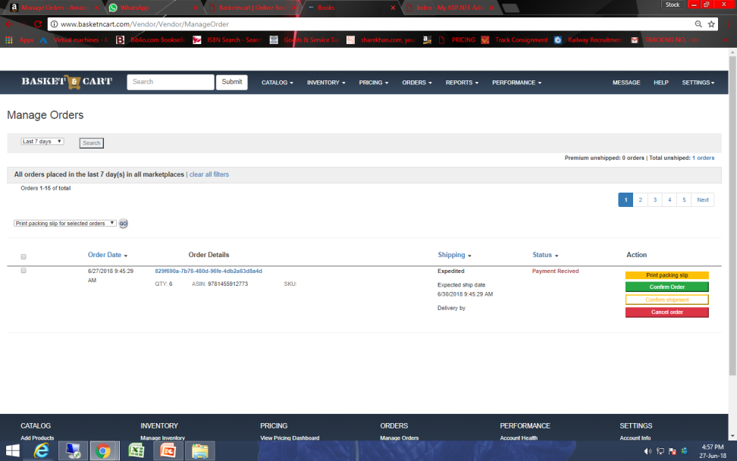
85. There is not option to filter
Amazon
Basketncart

Slide 3
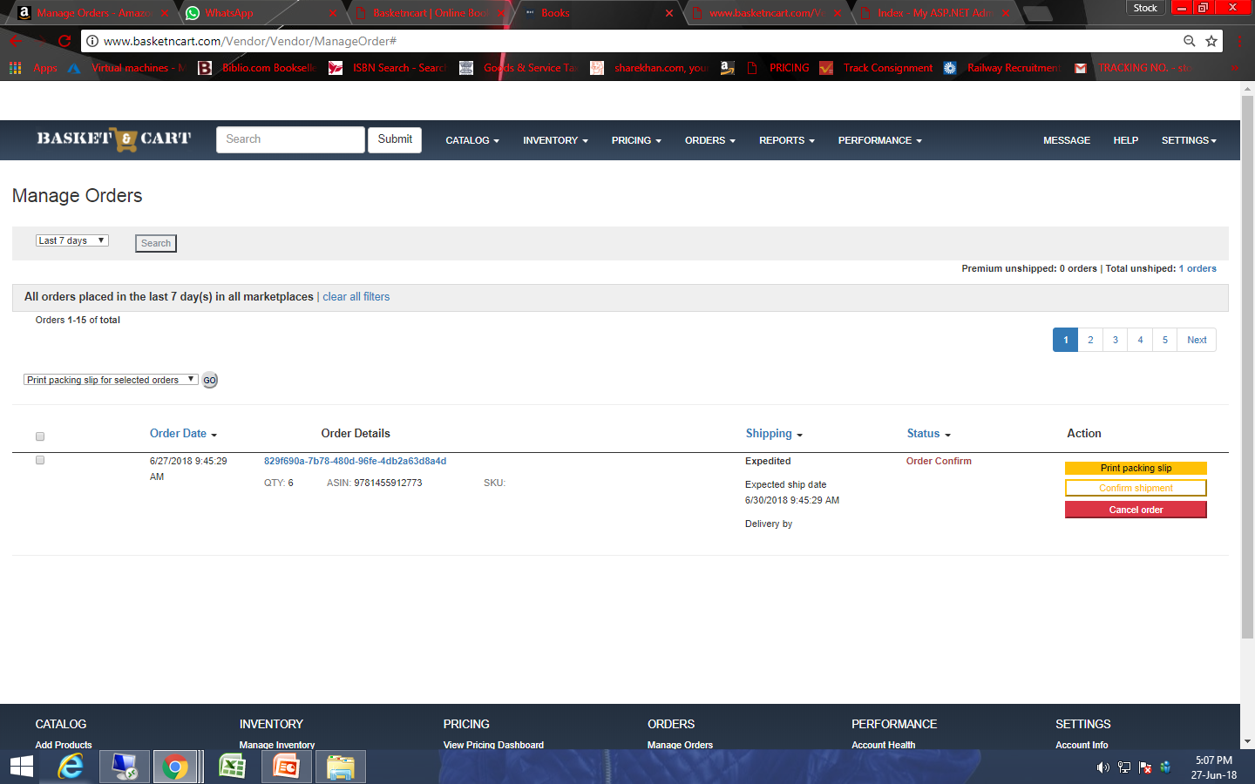
90. Order id comes with just 7-9 numerical words.

